Slide 1
Getting Started with
Ten Thousand Coffees

Slide 2
The power of informal career development
Most great career advice and professional development opportunities start with something simple
— a meaningful conversation
These informal development opportunities between students, recent grads, alumni and employers are where we learn and grow the most

Slide 3
What is Ten Thousand Coffees?
Ten Thousand Coffees an informal mentorship and career development platform that helps youth and industry professionals build their network by connecting them with alumni, peers, mentors and leaders who can help them reach their development goals.
Ten Thousand Coffees works with academic institutions, enterprises and communities from around the world to enable meaningful, human-to-human experiences — all through the power of conversation.
To help young people prepare for the future of work, RBC Future Launch and Ten Thousand Coffees have partnered to increase access to networking and mentoring for students at Universities and Colleges across the country.

Slide 4
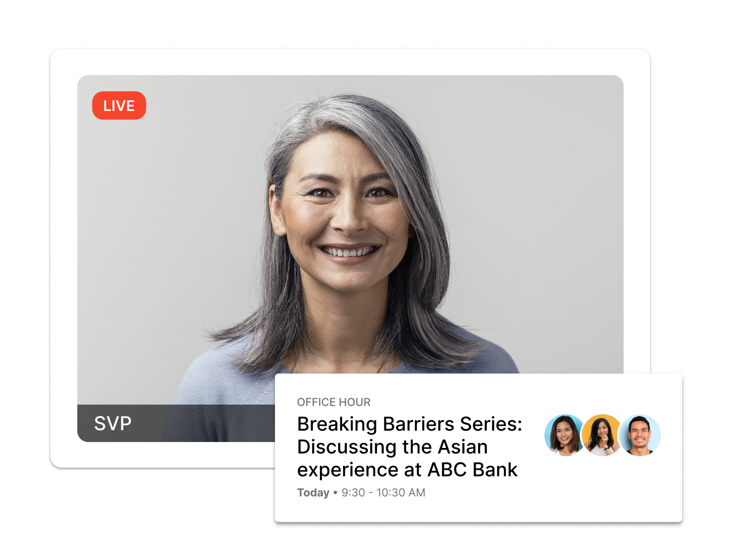
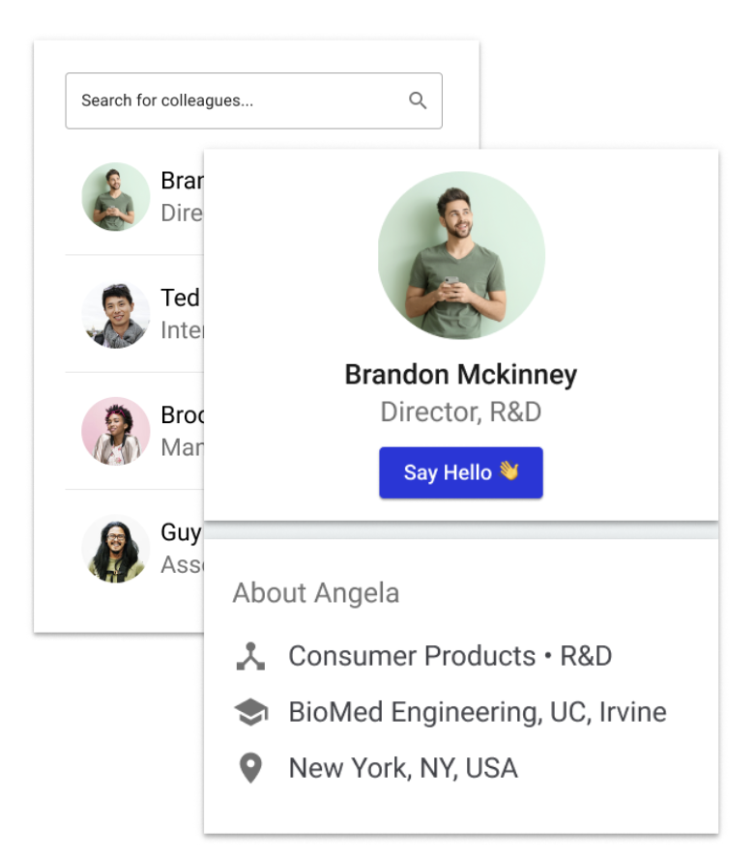
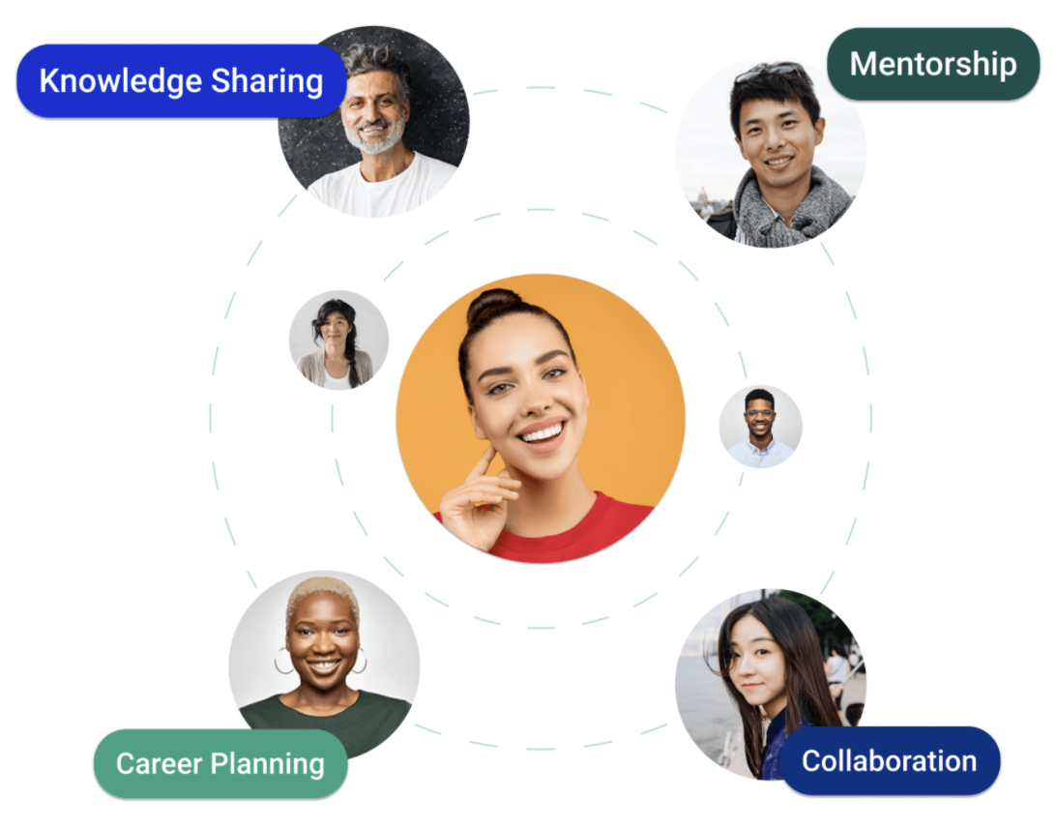
Three ways to make the most of 10KC
1:1 Career Conversations with
INTRODUCTIONS
Group Matching
with
OFFICE HOURS
MEMBER DIRECTORY
Search for members...
Networking conversations
Engage with leaders
Mentors at your fingertips
Opt-in to be Smart Matched for informal 1:1 networking conversations based on your goals and interests
Join group conversations hosted by alumni, recruiters and career experts to gain insights into pertinent topics
Easily connect with any member and learn more about them

Slide 5
Launch your career
STUDENTS & RECENT GRADUATES
Tap into Ten Thousand Coffees to:
Network with alumni, employers and industry professionals based on common goals or interests
Attend group mentorship conversations to gain access and learn directly from leaders
Gain and develop skills outside the classroom and learn how to launch your career
“
My connections have given me different perspectives on the job market and the corporate world. I have also gained new ideas on how to move my career forward. I'm starting to feel more comfortable with networking in general.
Melissa, student

Slide 6
Who can help me with career development?
Mentor, network and develop
ALUMNI
EMPLOYERS
Connect and recruit
Give back to their alma mater and stay connected with the community
Grow their network through connections with youth, alumni and employers based on common goals or interests
Host & attend group mentorship conversations to share insights and develop career and leadership skills
Connect with a community of top talent at various stages of their careers
Grow their network through connections with youth, alumni and other employers based on common goals or interests
Host & attend group mentorship conversations to share insights and attract quality candidates

Slide 7
How is Ten Thousand Coffees different from LinkedIn?
Ten Thousand Coffees will Smart Match you with another member of your community every month based on your identified interests and goal 🧠
= more meaningful, personalized connections 🤝
Everyone in your Ten Thousand Coffees community is there for mentorship and career development 📈
= no awkward or surprising outreach messages to other members - we know why you want to connect and we encourage you to do so! 💬

Slide 8
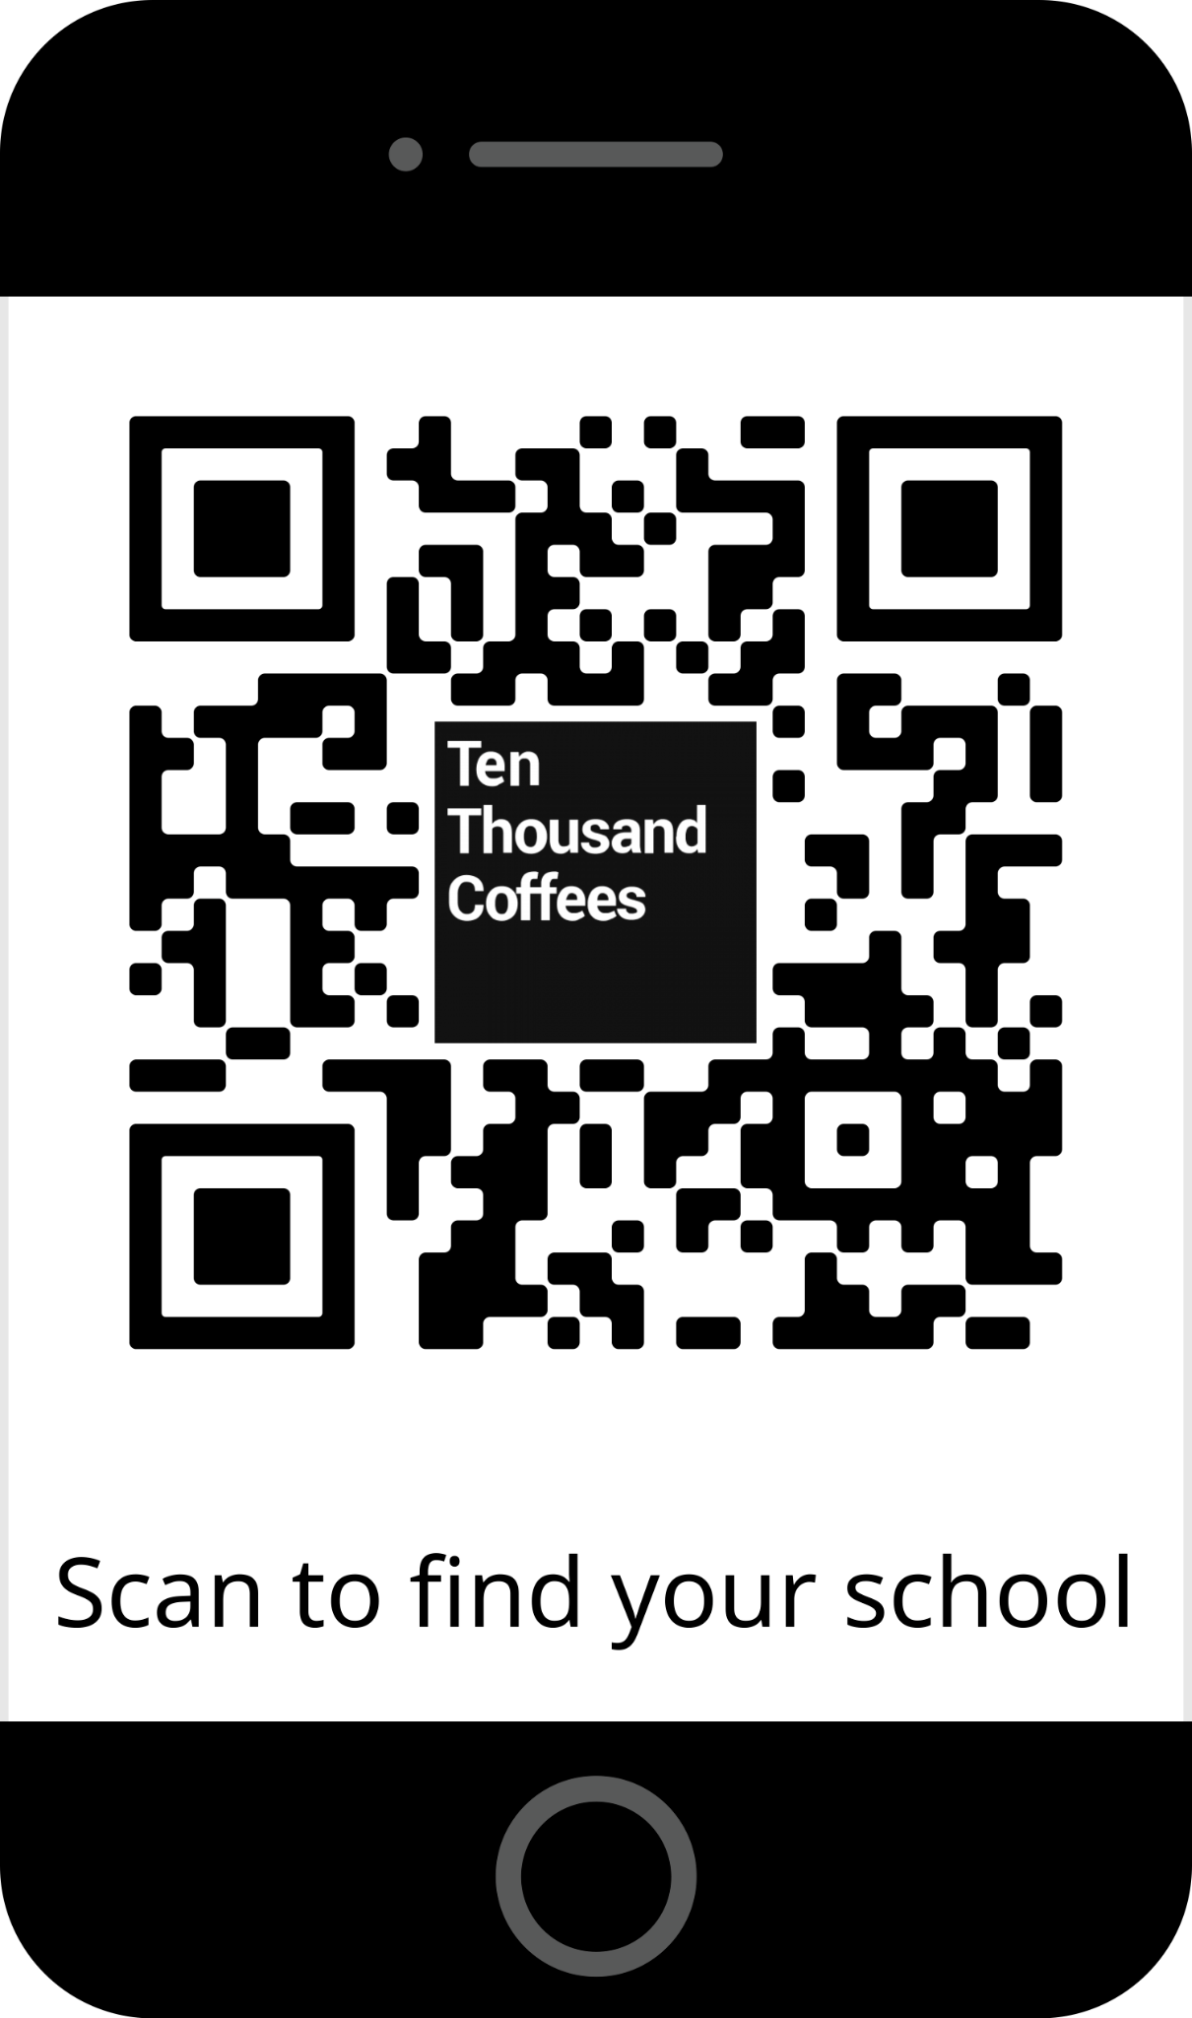
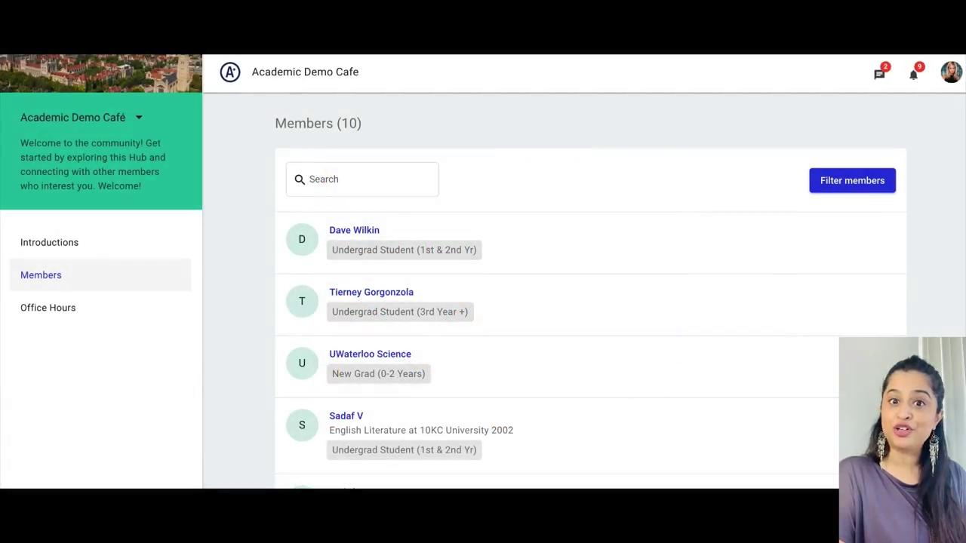
3 easy steps to join
Watch this video here to see it in action!
Head to tenthousandcoffees.com/schools or scan this QR code to join your community
Enter your name and email, click the JOIN TODAY button and complete your profile
Verify your email address
That’s it - you’re in 🙌

Slide 9
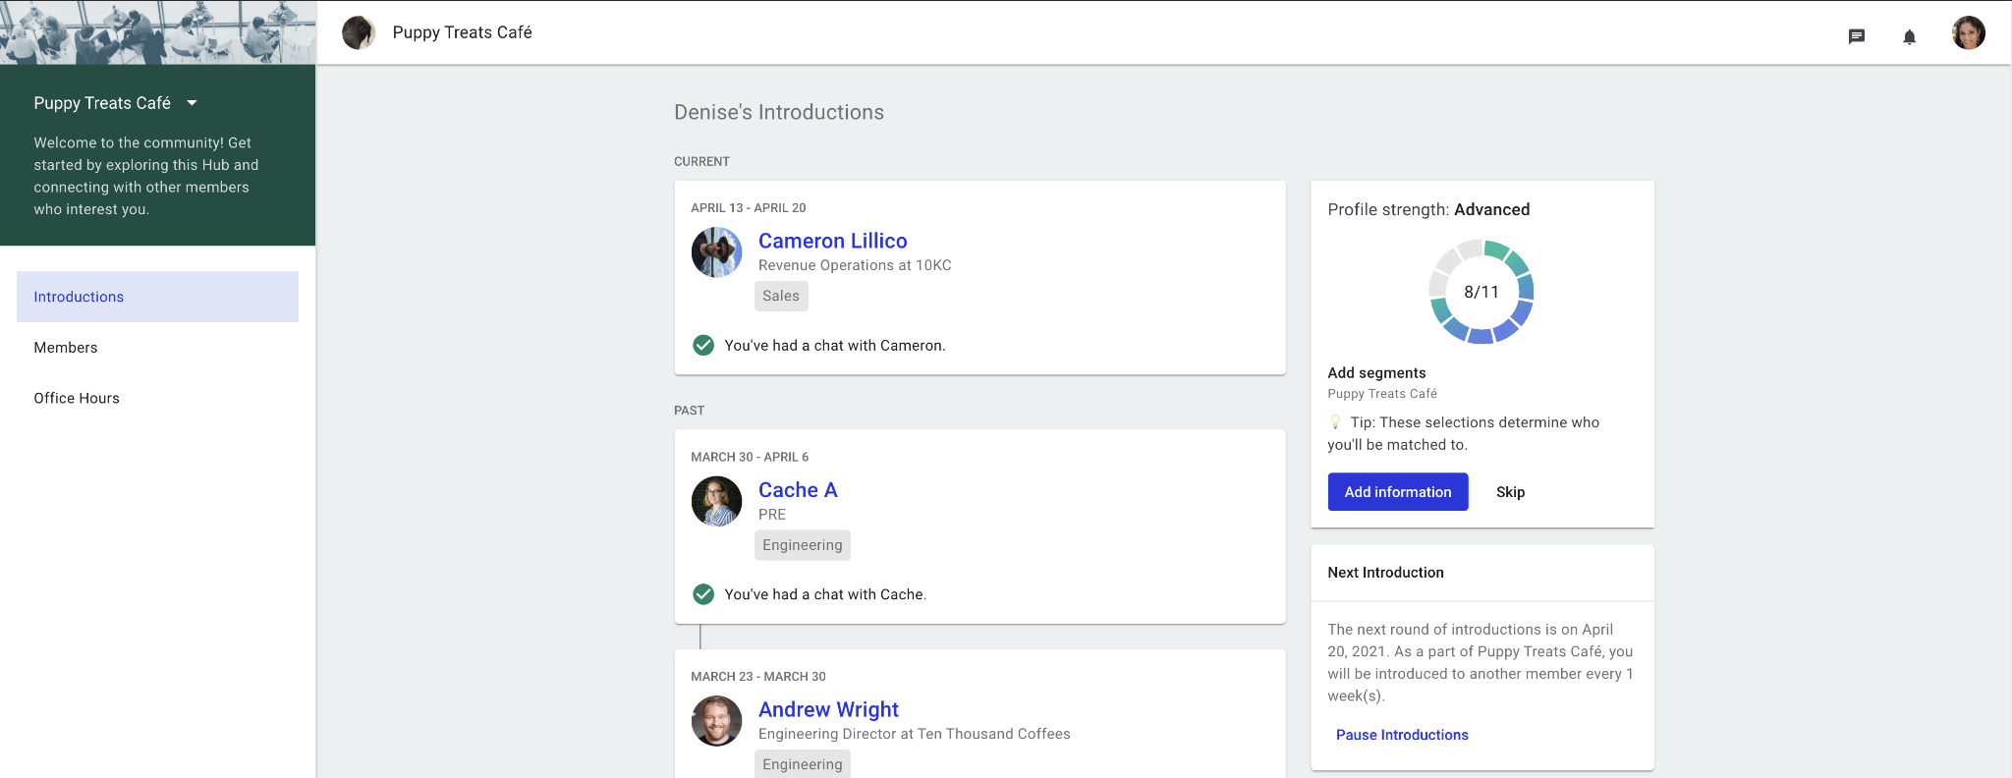
Now that I’m in - what’s next?
Click Members to search for people you’re interested in connecting with
Check out Office Hours for upcoming career development group conversations
Your personalized monthly match will arrive in your inbox at the next Introduction cycle!

Slide 10
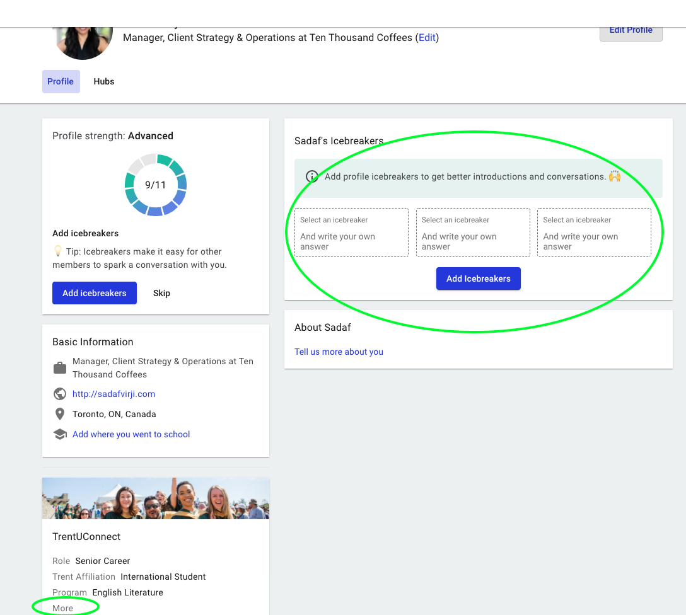
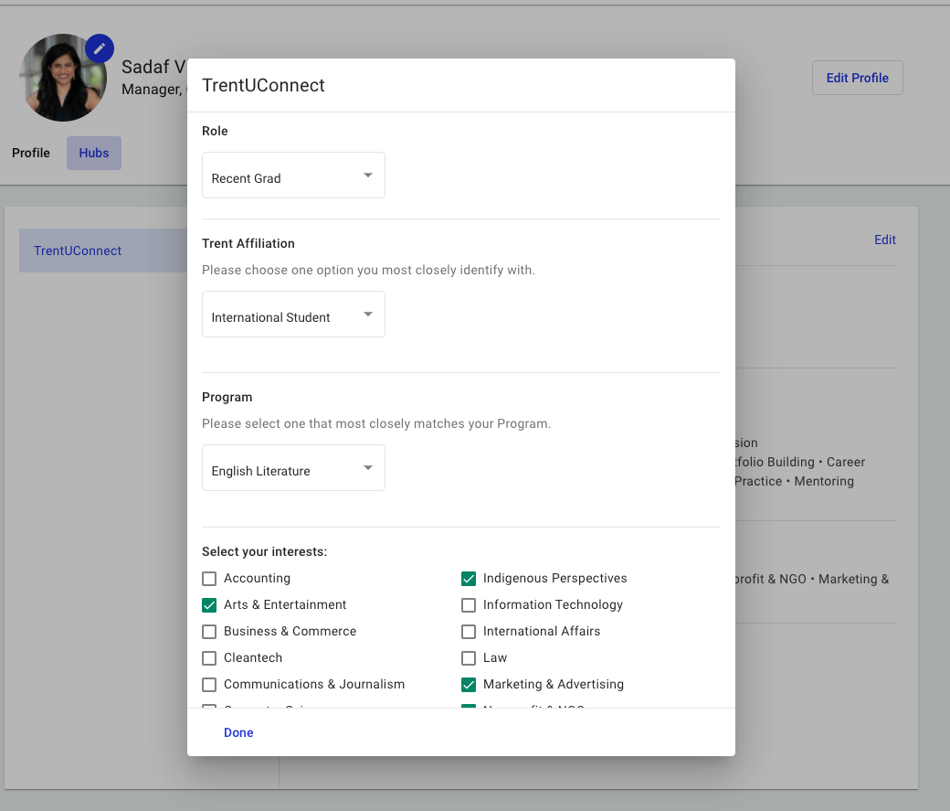
If you’re already a member, don’t forget to update your profile!
Go to {{nameofyourschoolhub}}.tenthousandcoffees.com/profile
Update your profile + your role, goals and interests to continue to receive the most relevant matches
Add or update your Icebreakers + update your Basic Information
Click More on the bottom left to access roles, program, goals & interests
Update your role to Recent Grad (yay!) + goals, interests and interactions

