Slide 1
TESTING SERVICES
Faculty Test Upload Instructions
Revised April 30, 2022
Notes:
Title Slide

Slide 2
INTEGRATION FOR TESTING
To get started, the Testing Services system integration needs to be activated within your course.
For Humber faculty, this means you need to add the integration through the Content Market in Blackboard. Continue to the next slide.
For Guelph-Humber faculty, the integration is automatically listed on the top menu, noted as Testing Services so no action is required. Continue to slide 6.
Notes:
Section Start Slide

Slide 3
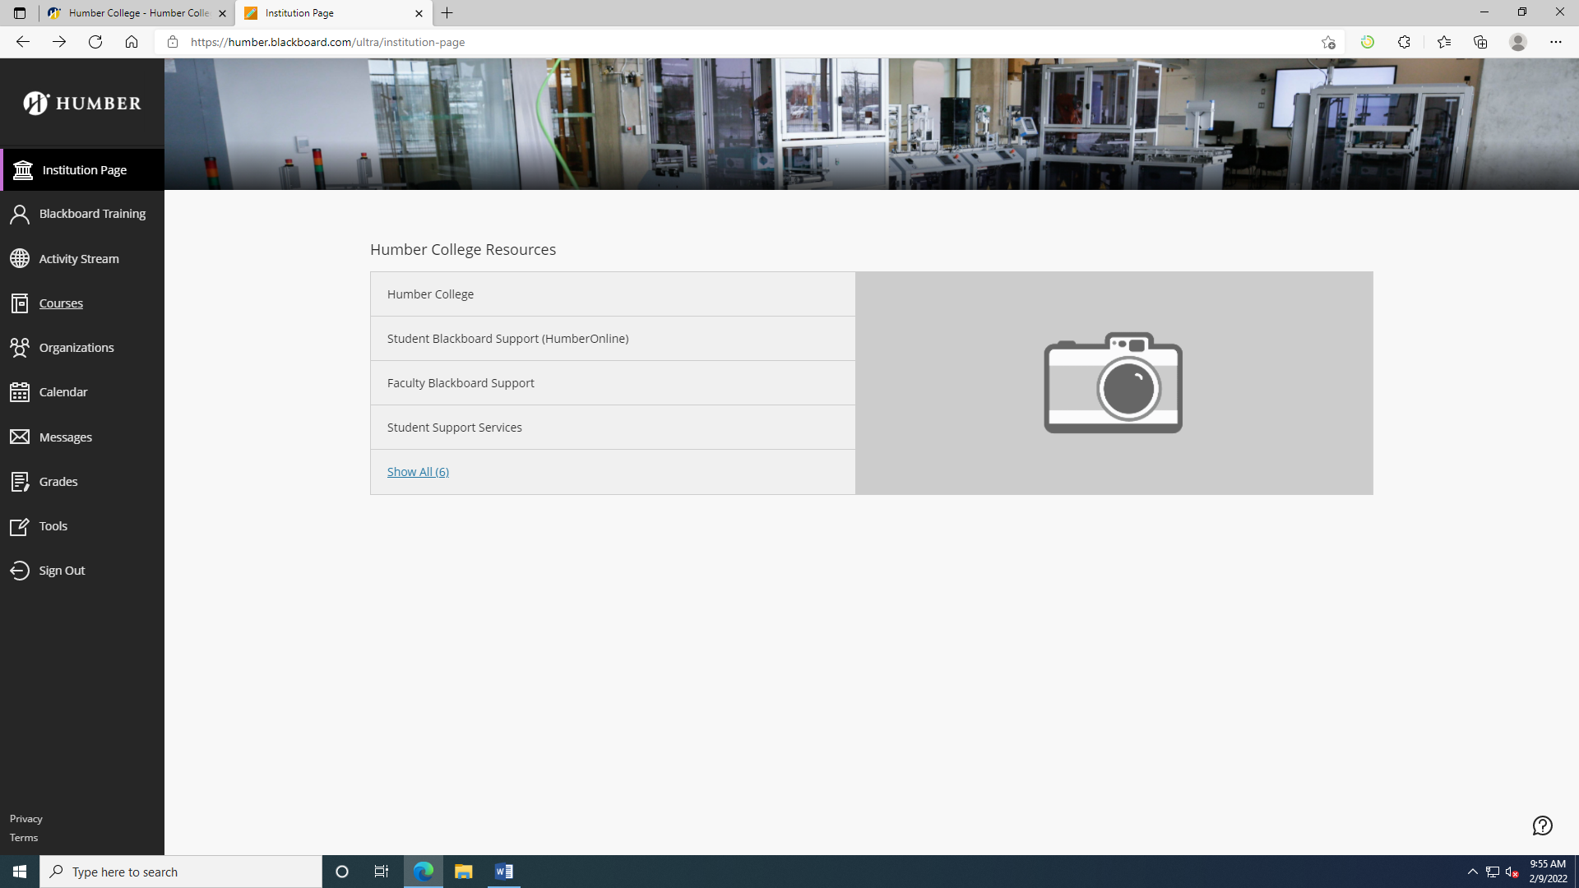
Step 1
Login to Blackboard at learn.humber.ca and click on Courses on the left-hand menu.
Notes:
Content Slide

Slide 4
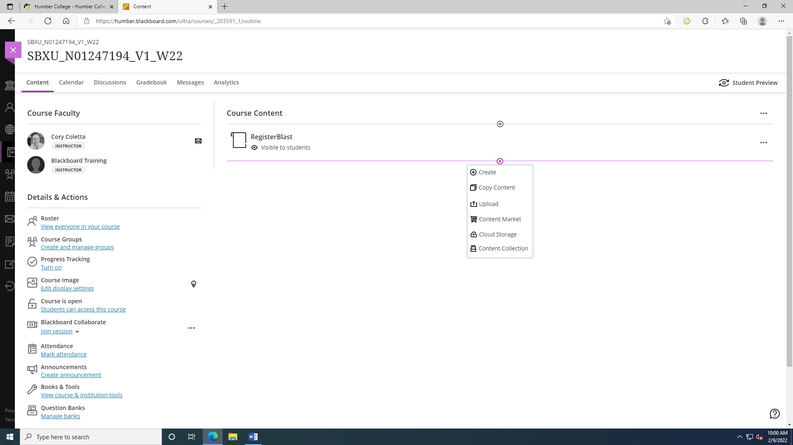
Step 2
In Course Content, choose the + and then choose Content Market.
Notes:
Content Slide

Slide 5
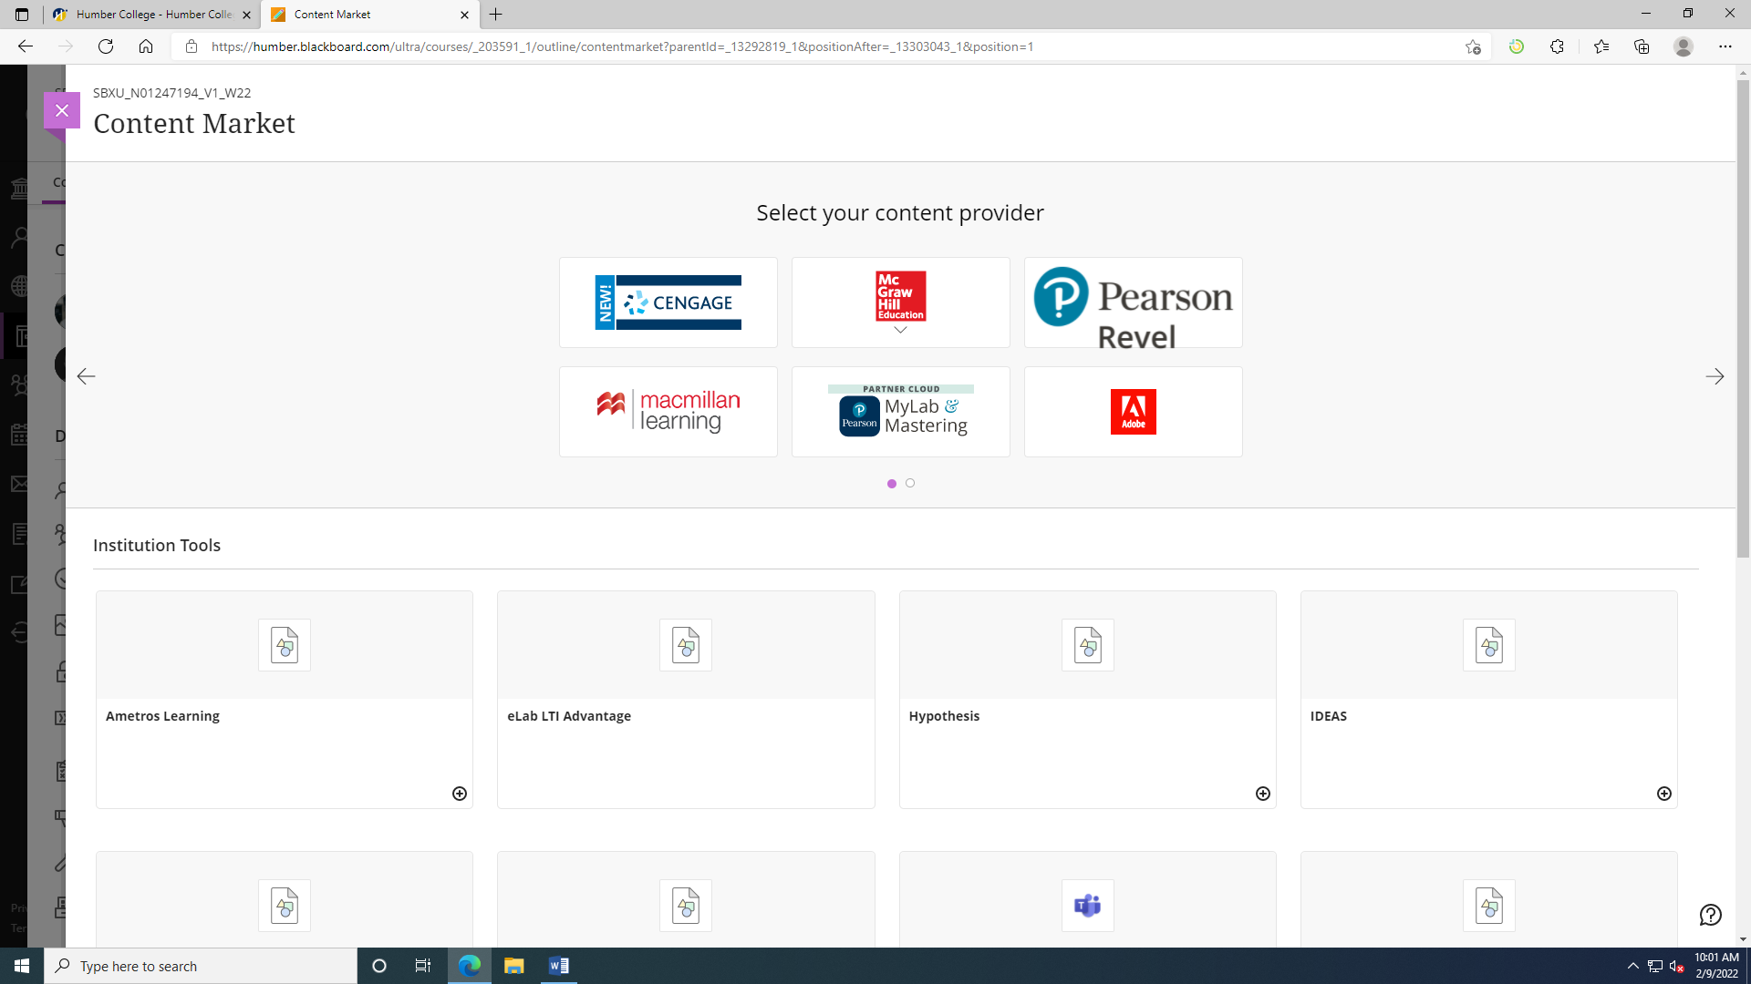
Step 3
In the Content Market, search for Testing Services – North and click on it to integrate into your course. Repeat this step and choose Testing Services – Lakeshore the second time. Every course requires both integrations.
Notes:
Content Slide

Slide 6
SUBMITTING A TEST
You can now launch the test submission portal through your course’s homepage.
For Humber courses, this means clicking on Testing Services – Lakeshore first in Course Content. Once the window is loaded, you can simply close it. Next, click on Testing Services – North and complete the submission.
For Guelph-Humber courses, this means clicking on Testing Services on the top menu.
Notes:
Section Start Slide

Slide 7
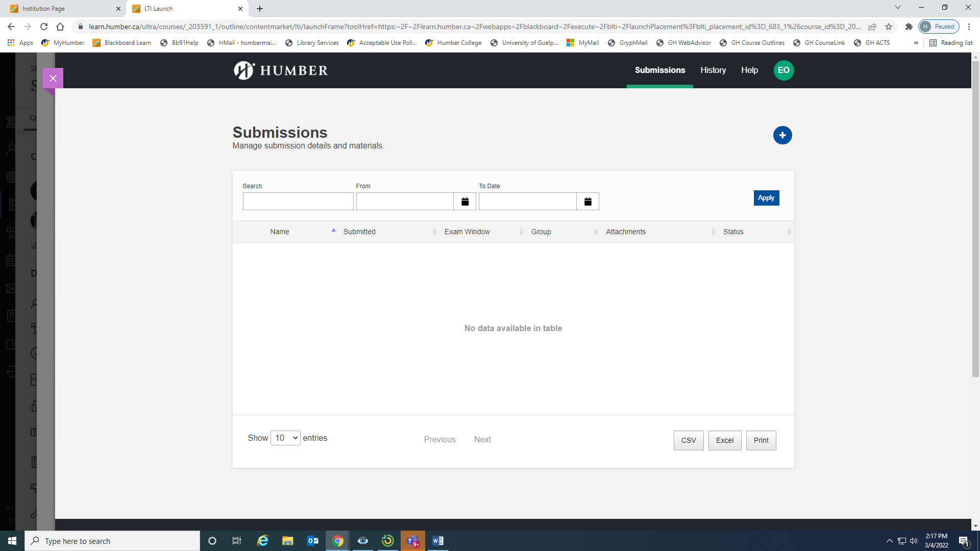
Step 1
After launching the Testing Services – North portal, you will begin to submit your test. Within the Submissions tab at the top, choose the + to begin.
Notes:
Content Slide

Slide 8
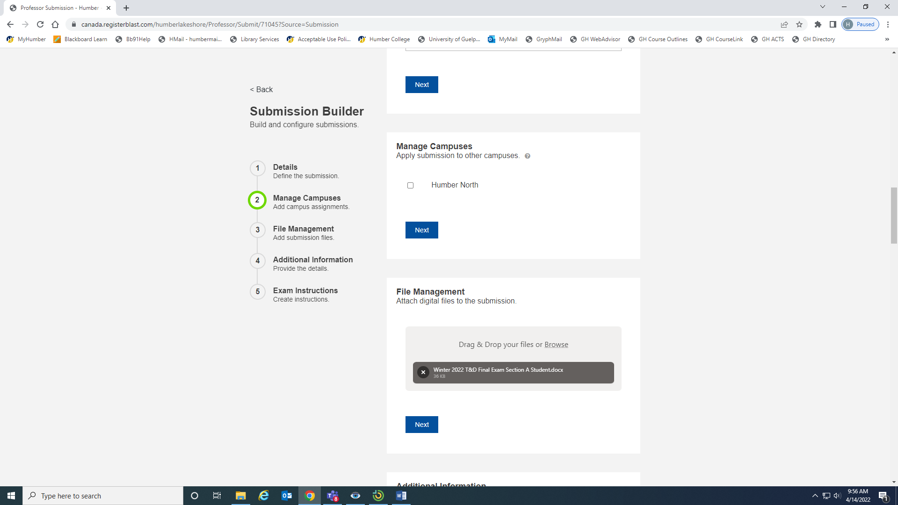
Step 2
Complete the submission form and click Submit at the bottom of the screen to upload the test to Testing Services and make it available for booking for your learners.
Notes:
Content Slide

Slide 9
YOU’RE DONE
Once you have submitted your test to Testing Services, your learners are able to write within the Test Centres.
Thank you!
Notes:
Section Start Slide

