Slide 1
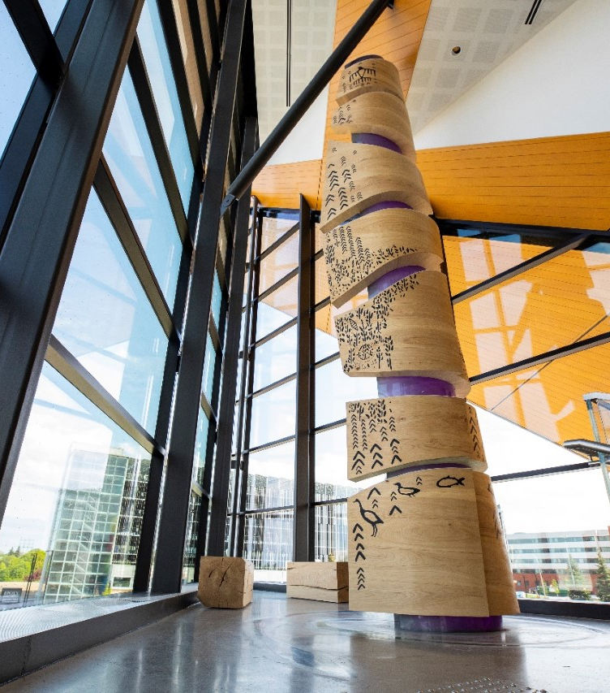
Barrett Centre for Technology Innovation
Green Building Project Summaries
Barrett Centre for Technology Innovation
Opening Day: 4/1/2019
The Barrett Centre for Technology Innovation (Barrett CTI) pioneers a new educational model, focusing on sustainable building practices, automated manufacturing and human-centred solutions for the 21st century. Located at Humber’s North Campus, the 93,000-square-foot facility is a living laboratory that omits traditional classrooms entirely. Interdisciplinary teams of students, faculty, industry partners and community members make use of interactive technology zones, digital media studios, cutting-edge prototyping and maker spaces, interactive demonstration areas and flexible open concept gathering spaces.
The central atrium, which is the grand entrance to the building and campus life, is a dynamic location to meet, work and socialize. The expansive space is utilized for idea-sharing, showcasing new products and exploring new technologies. Residential suites on the top floor allow industry advisors to live on-site while working on projects. Designed to inspire innovation, the Barrett CTI will enable students to immerse themselves in world-class technologies and mend the gap between education and real-world experiences.
The Barrett CTI is certified LEED-Platinum and the second-largest net-zero energy building in Canada at the time of construction, reflecting Humber’s commitment to providing national leadership in sustainable campuses. The sustainability features also function as teaching tools and include:
Passive heating and cooling systems;
A high-performance roofing system and building envelope;
Hydronic in-floor heating;
An abundance of natural, low-energy materials with long lifespans;
A green roof.
Several “truth windows” allow onlookers to view the buildings’ inner workings, another vital tool for teaching and learning.
 | Project Team
Project Manager | Colliers Project Leaders
Architect | Perkins&Will
Contractor | BIRD Construction
LEED Consultant | Fluent Group Consulting Engineering Inc.
Structural Engineer | Thornton Tomasetti
Mechanical Engineer | MCW Consultants
Building Science Professional | RDH Building Science Inc.
Building Code Consultant | LRI
Acoustical Consultant | Aercoustics
Accessibility Consultant | DesignABLE Environments
65%
Reduction in energy use compared to baseline building
85%
Construction waste diverted from landfill
Project
Highlights
34%
Of materials were locally sourced (within 800 km)
40%
Reduction in water use compared to baseline building
24%
Recycled content in building construction materials

Slide 2
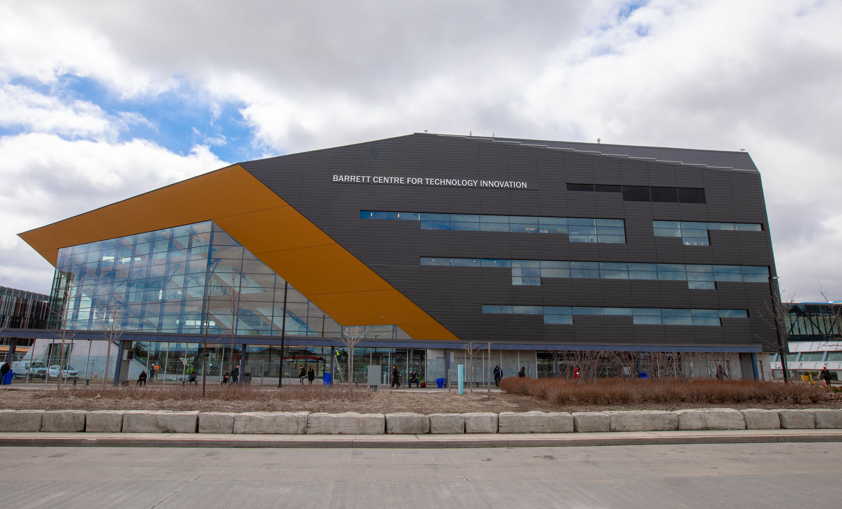
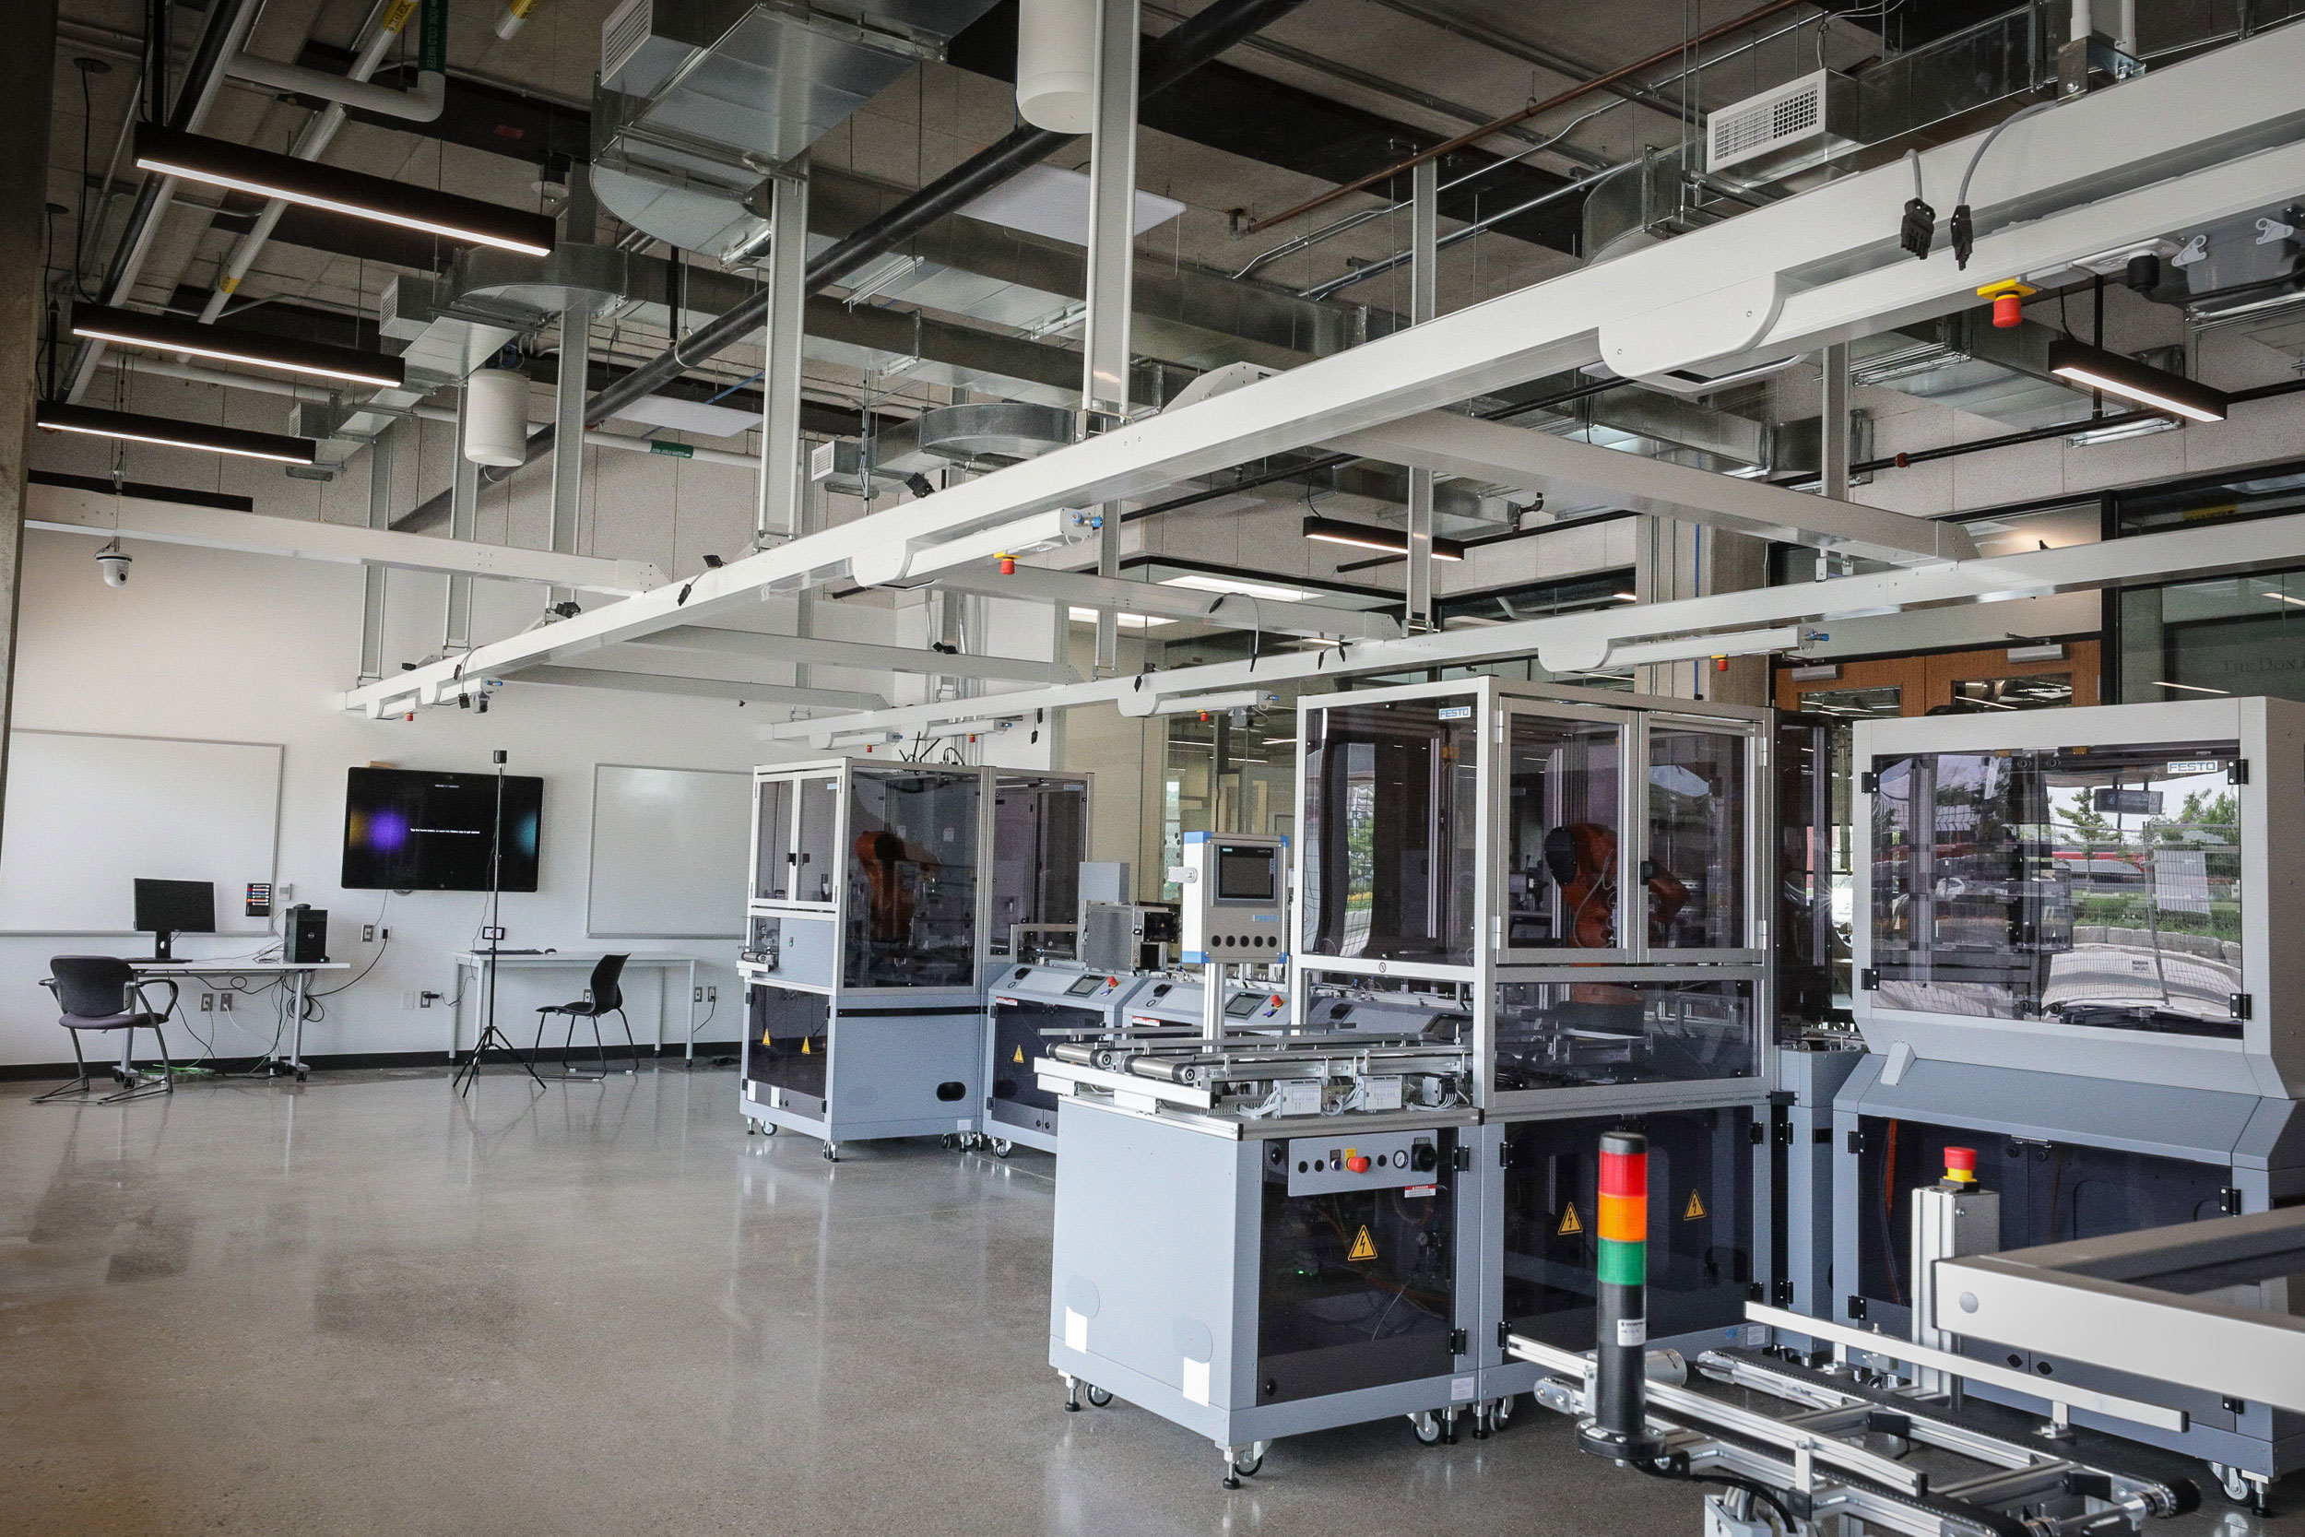
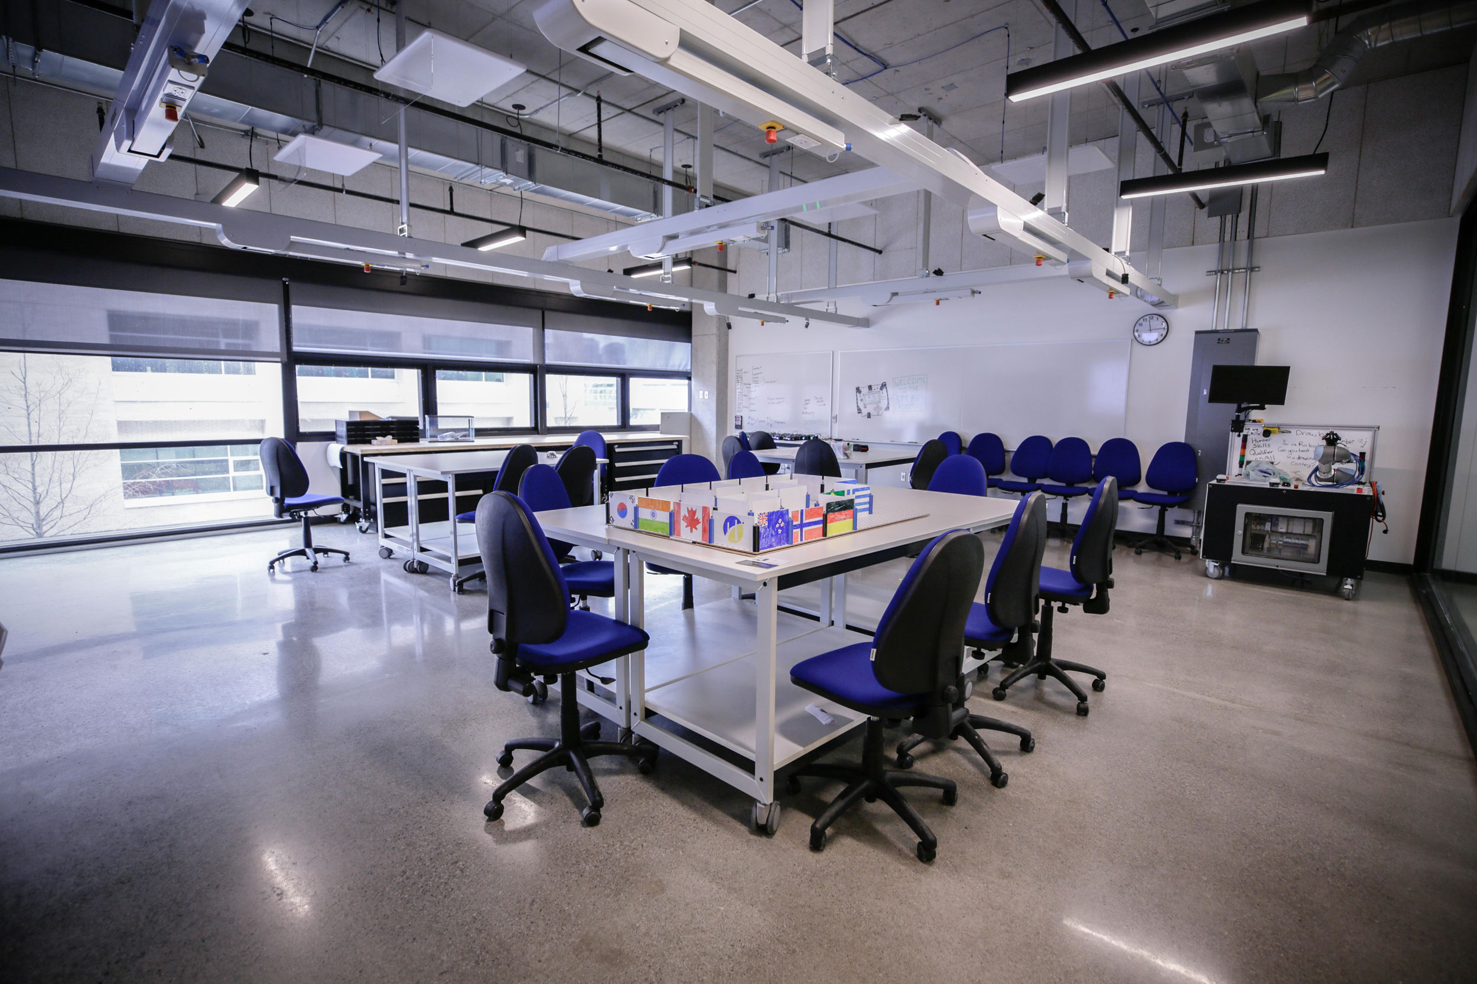
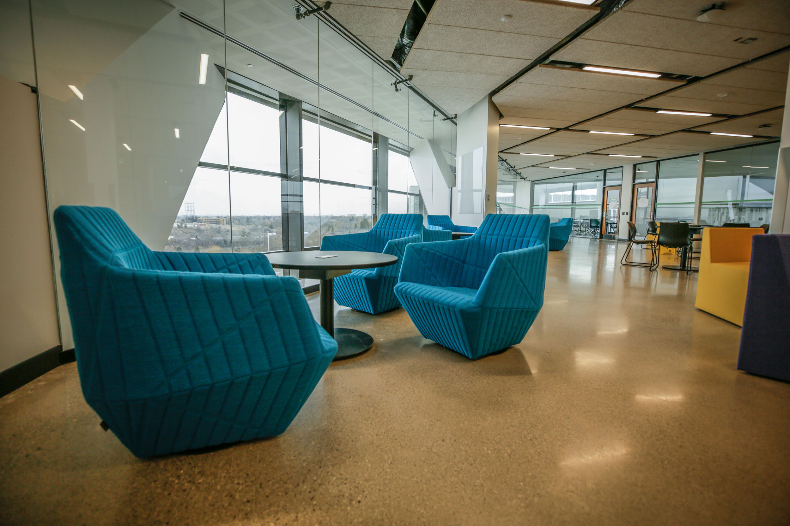
Project Overview
Part of the Community
The Barrett CTI reaches beyond student life; the buildings’ future-focused design compliments the surrounding network of campus open spaces and inspires innovation. The gravity-defying infrastructure is accessible and interactive, inviting community members to explore the area. The strategically placed building creates a new community hub for the rapidly growing campus. Connecting to trails, bike parking, and existing and new transit structures, including developing a light-rail transit (LRT)—the Barrett CTI is a gateway to campus life and the vibrant local community.
Energy, Water & GHG Efficiency
Energy Target: The Barrett CTI aligns with Humber’s long-term Integrated Energy Master Plan, which mandates that all new campus buildings achieve an energy use intensity (EUI) of 100kWh/m2/year. This aggressive EUI led to design interventions that used a conservation-first approach.
Passive Heating & Cooling Systems: The base building design for the Barrett CTI prioritized passive strategies and extensive energy conservation measures, including a moderate glazing-to-wall ratio of 40% focuses on glazing on where daylight is needed most in occupied areas; Brise Soleil shading devices on the south façade minimize heat gain and glare; and a multi-storey thermal chimney which allows natural ventilation in mild weather and 100% natural daylighting.
High-Efficiency HVAC: The building is provided with 95% efficient condensing style boilers serving DHW and service heating loop; dedicated outdoor air system with energy recovery enthalpy wheels to temper outside air and reduce energy, and distributed fan coils until to cut transmission energy use with hydronic systems instead of central systems.
Net-Zero Energy: The Barrett CTI is a net-zero energy building. The 700 KW-DC (580kW-AC) solar installation on the adjacent parking structure generates enough renewable energy to offset the buildings’ annual energy use.
High-Performance Roofing System & Building Envelope: Parametric design analysis, including solar and radiation, wind and day-lighting penetration, optimized both the massing and envelope resulting in a highly insulated façade and concrete floors acting as thermal mass in the lobby.
Green Roof: The building maximizes green spaces and has a partly vegetated enclosed roof and garden to manage stormwater runoff and mitigate potential infrastructure failure and associated financial burdens. The green roof engages students in the concepts of wellness and environmental stewardship.
Equity, Diversity, Inclusion, and Belonging
[Text placeholder]
X
X
X
X
X
X
x

